Slide 1
Esophageal surgery

Slide 2
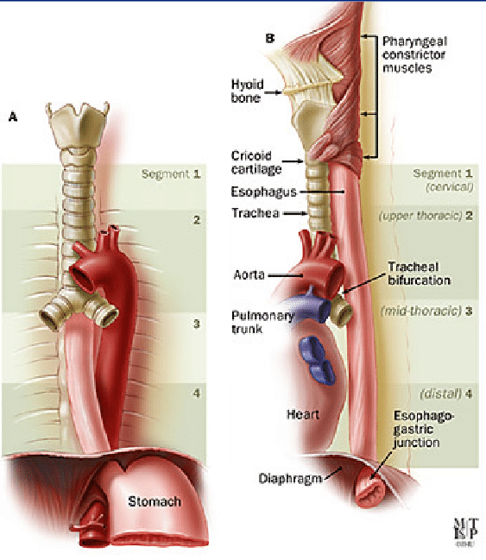
Esophagus
The esophagus is the connecting tube between the pharynx and stomach that functions to transport ingesta and fluids.
The outer layer of the esophagus is the adventitia.
In the neck, The esophageal adventitia blends with the deep cervical fascia.
In the thorax and abdomen, the adventitia is largely covered with pleura and peritoneum.
The esophagus is loosely connected to the diaphragm by a phrenicoabdominal membrane.

Slide 3
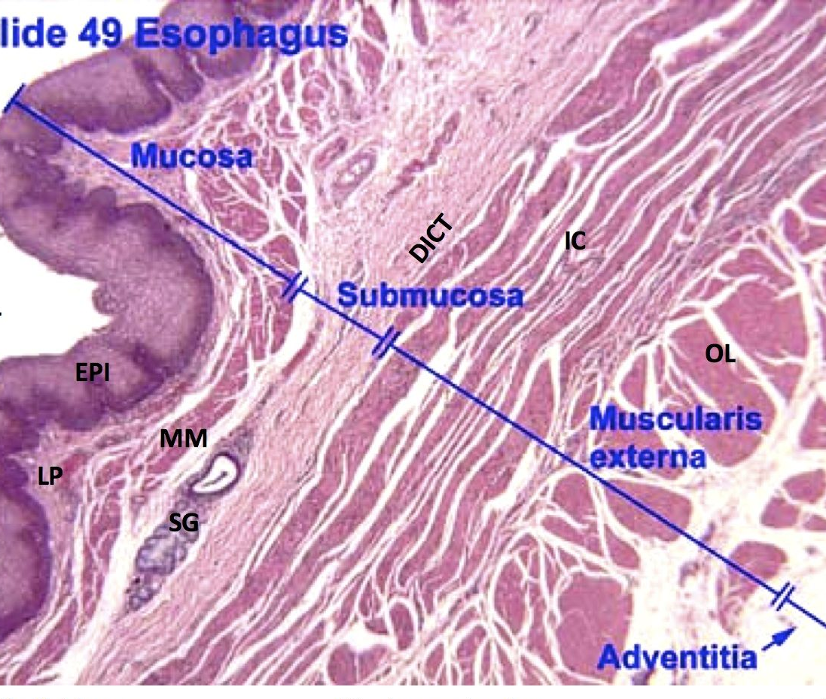
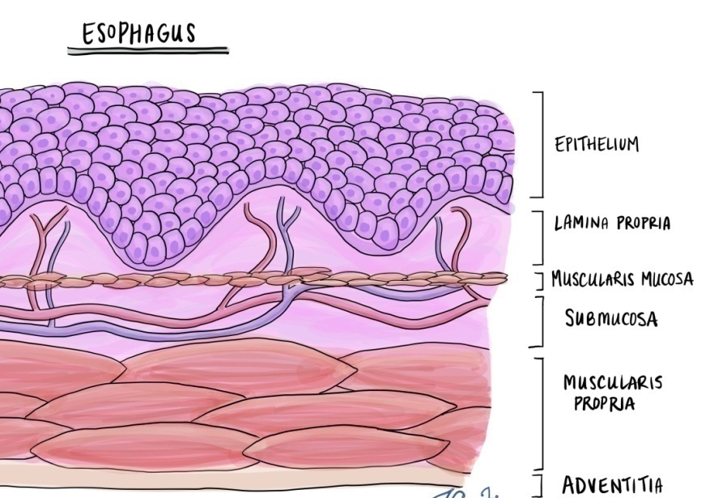
esophagus
The muscularis is composed of striated muscle for the entire length of the esophagus in dogs, but it changes to smooth muscle in the terminal esophagus in cats.
The submucosa loosely connects the mucosa and muscularis, allowing mucosa to move independently
The submucosa contains blood vessels, nerves, and simple mucous glands that secrete mucus, which lubricates the mucosal surface.
The esophageal mucosa is composed of a stratified squamous epithelium.

Slide 4
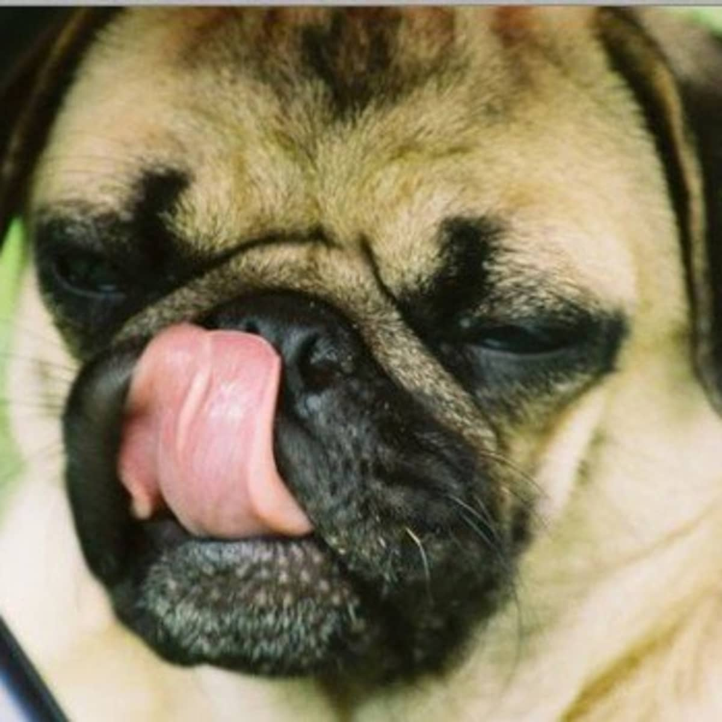
Causes of dysfunction of the esophageal phase of swallowing are divided into
1. mechanical or anatomic lesions: (mural lesion or compression from adjacent structures like foreign bodies or tumors)
2. functional or neuromuscular lesions (neuromuscular disease commonly causes megaesophagus)
3. inflammatory (esophagitis) conditions (include ingestion of corrosive substances, thermal burns, radiation injury, and esophageal foreign bodies.)

Slide 5
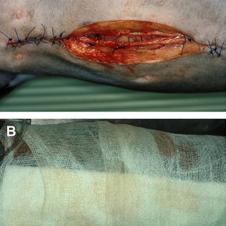
GENERAL SURGICAL PRINCIPALS
Esophageal surgery is associated with a higher incidence of incisional dehiscence than surgery on other portions of the alimentary tract.
In esophageal surgery, several factors may contribute to the high complication rate, including
lack of serosa,
the segmental nature of the blood supply,
the lack of omentum,
constant motion caused by swallowing and respiration,
tension at the surgical site.

Slide 6
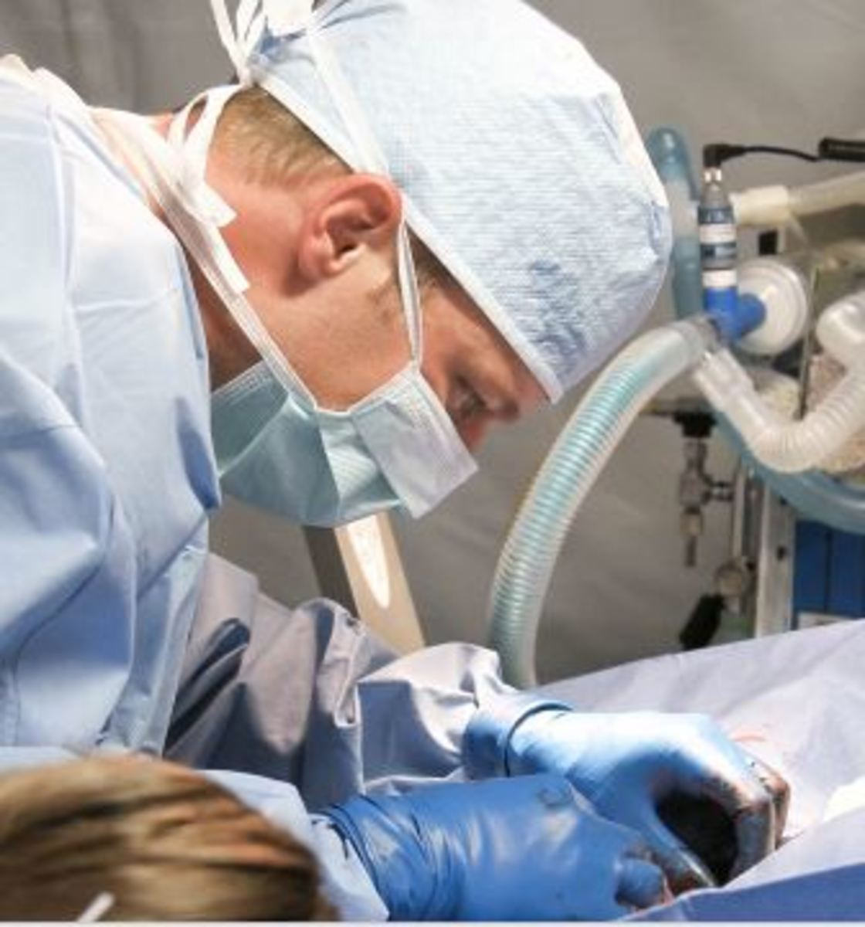
esophageal surgery can be successfully performed by following principles, including
gentle tissue handling,
minimization of contamination,
appropriate selection and application of suture materials,
appropriate use of electrocautery
accurate apposition of tissues.
In the abdomen, the serosa assists in healing of viscera by the elaboration of a fibrin seal soon after surgery and by providing a source of pluripotential mesothelial cells.
In the thoracic cavity, pleural mesothelium may play a similar role.

Slide 7
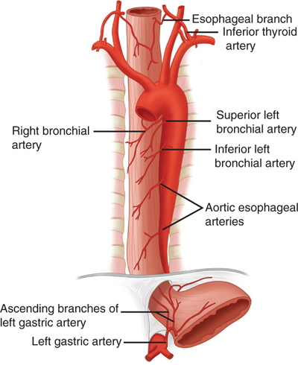
The blood supply to the esophagus is considered segmental, with a rich, intramural plexus of anastomosing vessels in the submucosal layer that can support long segments of the esophagus.
Postoperative motion of the esophageal incision with swallowing and respiration is unavoidable.
After esophageal surgery, food and water are normally withheld to reduce esophageal motion and eliminate the passing of ingesta across the surgical site.

Slide 8
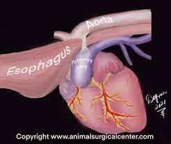
DISEASES OF THE ESOPHAGUS
Vascular Ring Anomalies
Vascular rings are developmental anomalies of the great vessels that result in the encircling of esophagus and trachea by a complete or incomplete ring of vessels.
*Several types of vascular ring anomalies are described in dogs and cats. The most common vascular ring anomaly is persistent right aortic arch with a left ligamentum arteriosum, in which the aortic arch develops from the right fourth aortic arch
الشذوذ الأكثر شيوعًا في الحلقة الوعائية هو قوس الأبهر الأيمن المستمر مع الرباط الشرياني الأيسر ، حيث يتطور قوس الأبهر من قوس الأبهر الرابع الأيمن.
The clinical signs of vascular ring anomalies are caused primarily by esophageal obstruction. Initially, regurgitation usually occurs soon after eating, but later it may occur at variable time (minutes to hours).

Slide 9
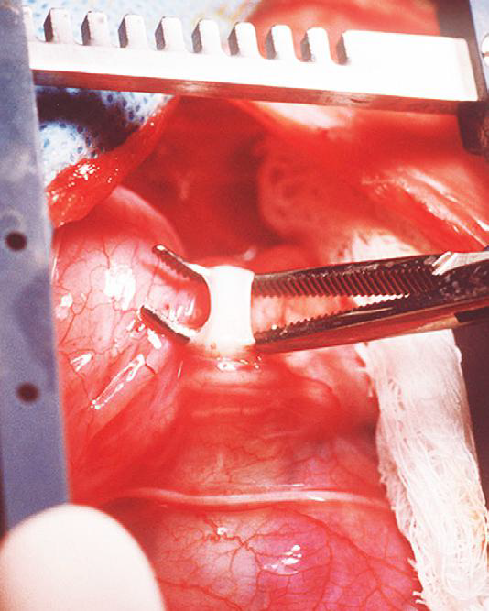
Treatment
Most vascular ring anomalies can be corrected through a left lateral thoracotomy.
The ligamentum arteriosum is carefully dissected from the esophagus with right-angled forceps double ligated with silk suture, and transected.
Prognosis in dogs has improved over the past several decades.

Slide 10
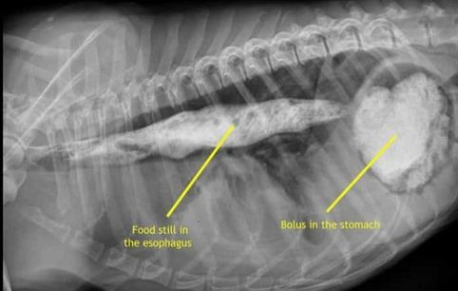
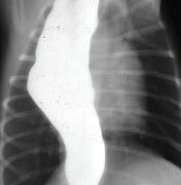
Congenital Generalized Megaesophagus
Idiopathic مجهول السبب congenital total megaesophagus is caused by generalized alteration in motor function of the esophagus, possibly from a defect in vagal afferent innervation of the esophagus, and results in lack of aboral propulsion of foodنقص في دفع الطعام اللاإرادي
The entire esophagus becomes dilated, and esophagitis may develop as a result of fermentation of retained food.
Treatment :
Esophagodiaphragmatic cardioplasty using the Torres technique to improve esophageal emptying.

Slide 11

Esophageal Foreign Bodies
Esophageal foreign bodies are a common problem in dogs and are occasionally diagnosed in cats.
The most common foreign bodies in dogs are ingested bones. In cats, fishhooks, needles, and string foreign bodies are more common.
Small-breed dogs, particularly terrier breeds, are most frequently diagnosed with esophageal foreign bodies. Most affected dogs are younger than 3 years of age (64%)

Slide 12
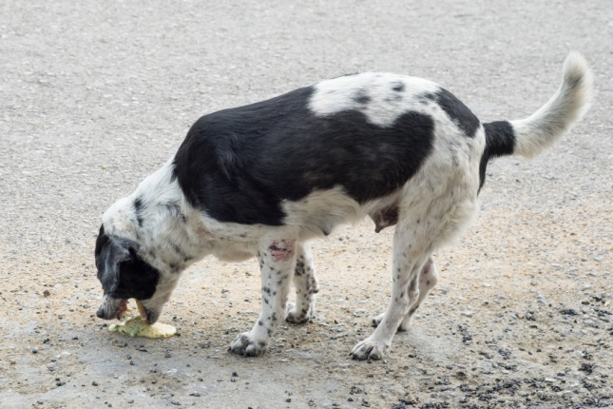

Esophageal Foreign Bodies
Acute clinical signs associated with complete or severe partial obstruction are usually seen. The most classic clinical sign is regurgitation of food within a few minutes of eating.
Other clinical signs include retching التهوع, gagging, excessive salivation, restlessness, lethargy، والأرق, and inappetence.
Sharp or chronic foreign bodies can result in esophageal perforation,

Slide 13
Treatment
An initial attempt should be made to extract the foreign body with endoscopy using grasping forceps.
يجب القيام بمحاولة أولية لاستخراج الجسم الغريب بالتنظير الداخلي أو التنظير الفلوري باستخدام ملقط الإمساك
the firmly lodged foreign body should not be forced because this may induce or enlarge a perforation. Then Surgical repair of perforations should be considered
لا ينبغي إجبار الجسم الغريب المستقر بقوة لأن هذا قد يؤدي إلى حدوث ثقب أو تكبيره.
Esophageal foreign bodies should be surgically removed when retrieval or advancement of the foreign body fails or when forceps extraction presents a significant risk for laceration of the esophagus or major vessels
يجب إزالة الأجسام الغريبة من المريء جراحيًا عند فشل استرجاع أو تقدم الجسم الغريب أو عندما يمثل استخراج الملقط خطرًا كبيرًا على تمزق المريء أو الأوعية الرئيسية
Prognosis
The prognosis after foreign body removal is generally excellent except in cases of thoracic esophageal perforation

Slide 14

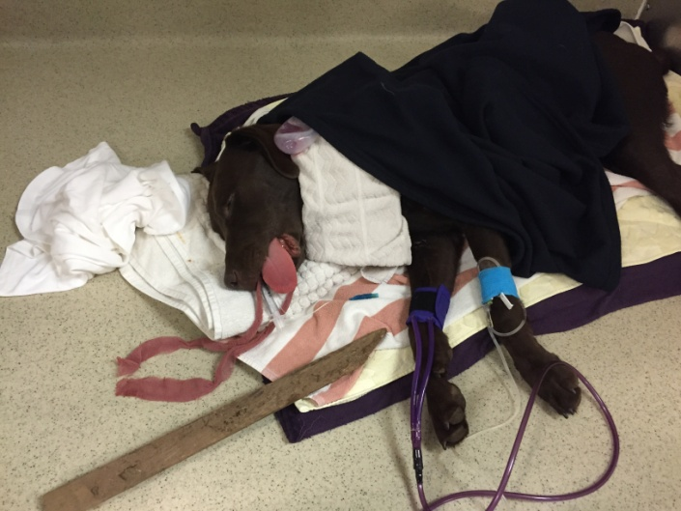
Esophageal Lacerations
Esophageal lacerations are most commonly caused by penetrating esophageal foreign bodies. The most common injury is a penetrating stick injury in dogs that carry, chew, or retrieve sticks. Esophageal stick injuries generally occur in the cervical esophagus.
Esophageal lacerations can also occur with external trauma such as bite wounds
Treatment
Foreign material is removed surgicaly, the esophageal laceration is minimally debrided, and a single- or double layered closure performed. The surgical site is lavaged before closure, and a closed suction drain can be placed.
Acute esophageal penetrating injuries have a poorer prognosis

Slide 15
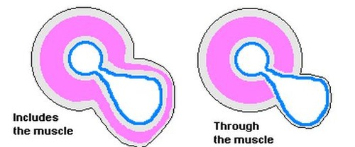
Esophageal Diverticula
Esophageal diverticula are rare in dogs and cats.
Diverticula are divided into pulsion and traction types.
A pulsion diverticulum is an outpouching of mucosa that herniates through a defect in the tunica muscularis. It is thought to be caused by increased luminal pressure as a result of a mechanical (e.g., foreign body or stricture) or functional esophageal obstruction..
A traction diverticulum is a full-thickness deviation of the esophageal wall. The term traction refers to the assumed pathogenesis, namely inflammation in an adjacent organ causing formation of an adhesion. Subsequent contraction of the adhesion pulls the esophagus outward to form a pouch
The diverticulum can become impacted with ingesta, distorting and obstructing the esophageal lumen

Slide 16
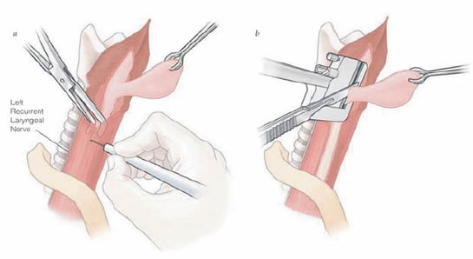
Treatment
Small diverticula may be treated conservatively by feeding a gruel-type diet with the animal in an upright position
يمكن معالجة الرتج الصغير بشكل وقائي عن طريق تغذية نظام غذائي من نوع العصيدة مع الحيوان في وضع رأسي
Large diverticula generally require surgical management. Excision of the diverticulum (diverticulectomy)
Prognosis
The prognosis in dogs with diverticula amenable to simple diverticulectomy is good

Slide 17
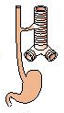
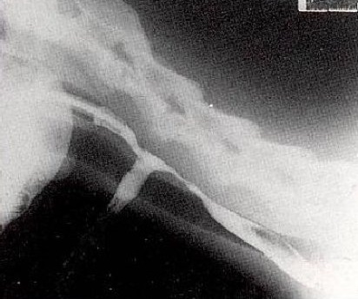
Esophageal Fistulae
An esophageal fistula is an abnormal communication between the esophagus and the trachea, bronchus, lung parenchyma, or (less commonly) the skin. Esophageal fistulae may be either congenital or acquired.
Congenital fistulae result from an incomplete separation of the tracheobronchial tree from the digestive tract
most acquired fistulae are secondary to esophageal foreign bodies
The most common clinical sign is coughing, which may be associated with drinking liquids. Other clinical signs include regurgitation, lethargy, anorexia, dyspnea, and weight loss.

Slide 18
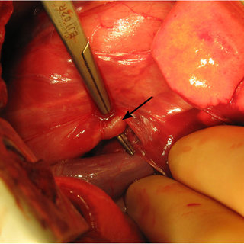
Treatment and Prognosis
Esophageal fistulae require surgical management.

Slide 19
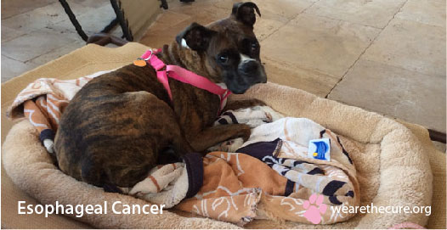
Esophageal Neoplasia
Esophageal neoplasia in dogs and cats is rare.
In dogs and cats, the most commonly reported primary esophageal tumors include squamous cell carcinoma,
Clinical Signs
The most common clinical sign is regurgitation or vomiting

